Slide 1





How Uses Data Warehousing to Make Smart Business Decisions ?

Slide 2

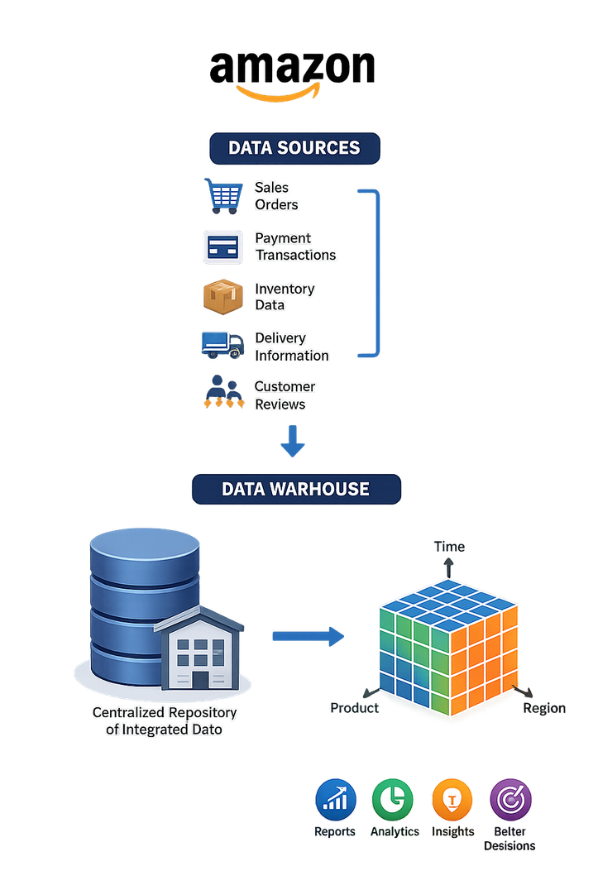
Introduction
Amazon processes millions of orders, payments, deliveries, and customer reviews every day.
This data is generated from multiple systems such as sales, inventory, customers, and logistics.
Managing data separately makes analysis and decision-making difficult.
A Data Warehouse integrates data from different sources into a centralized repository.
Business Intelligence (BI) and OLAP help Amazon analyze data and make faster, data-driven decisions.

Slide 3
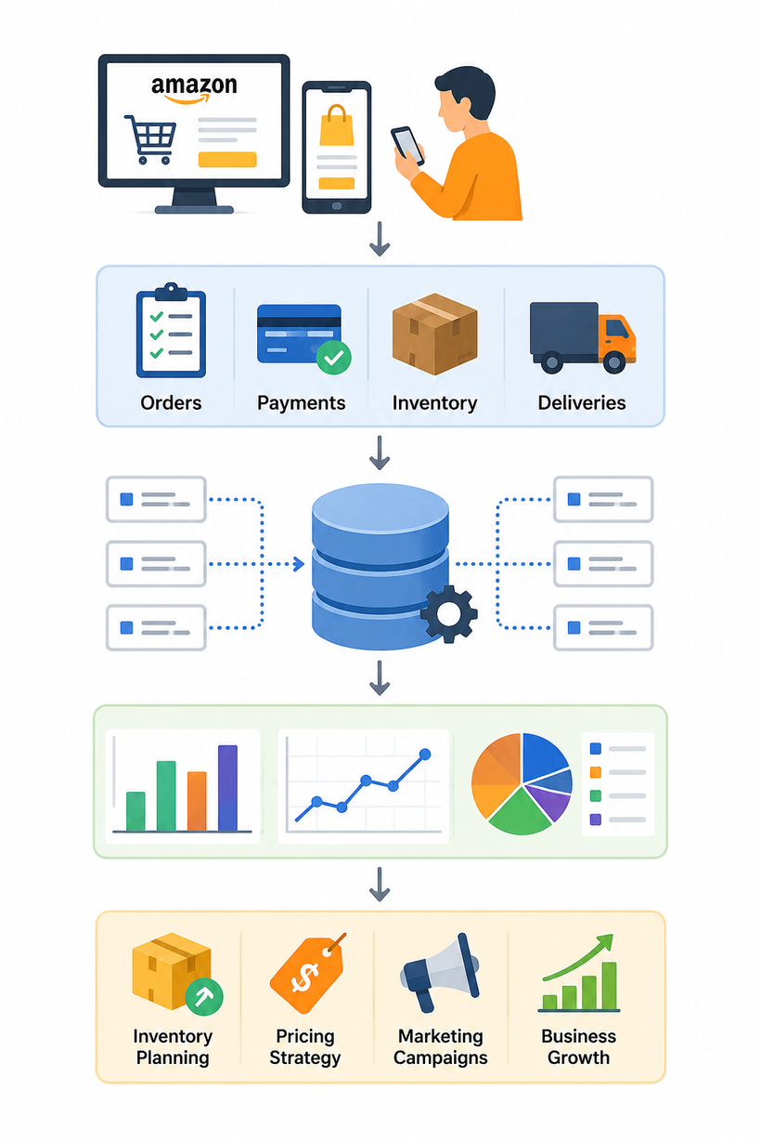
Operational System vs Decision Support System (Amazon Scenario)
Operational System (OLTP): Handles daily operations such as customer orders, payments, inventory updates, and deliveries in real time.
Decision Support System (DSS): Analyzes historical data to identify sales trends, customer preferences, and future demand.
Amazon Example: After every order is completed, the transaction data is stored in the Data Warehouse for analysis.
Business Benefit: Managers use reports and dashboards to make better decisions on inventory, pricing, and upcoming sales events.

Slide 4
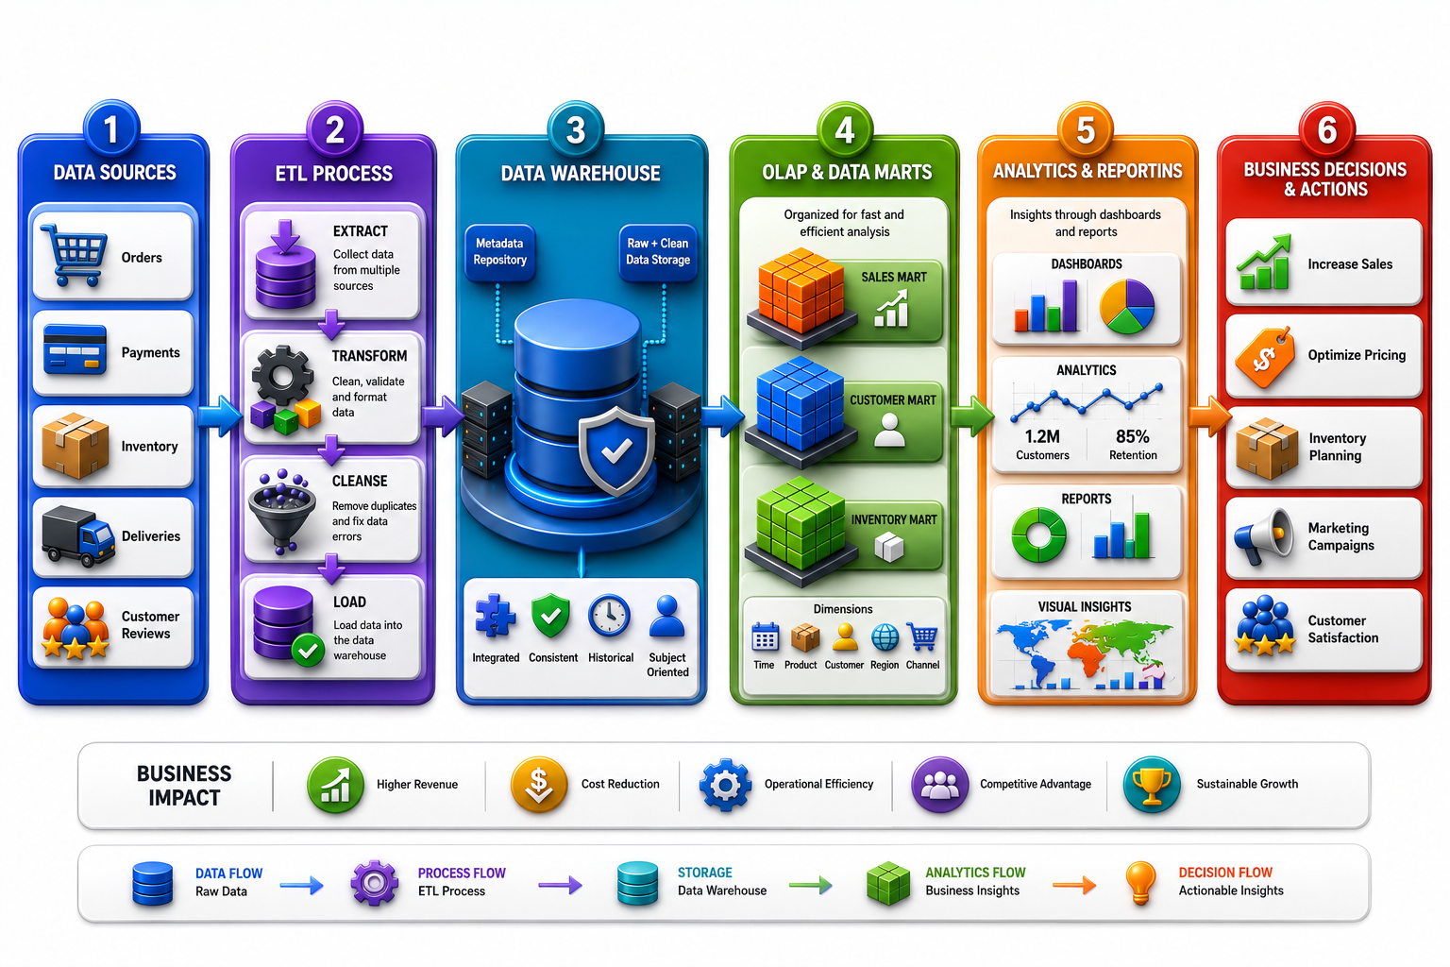

Slide 5
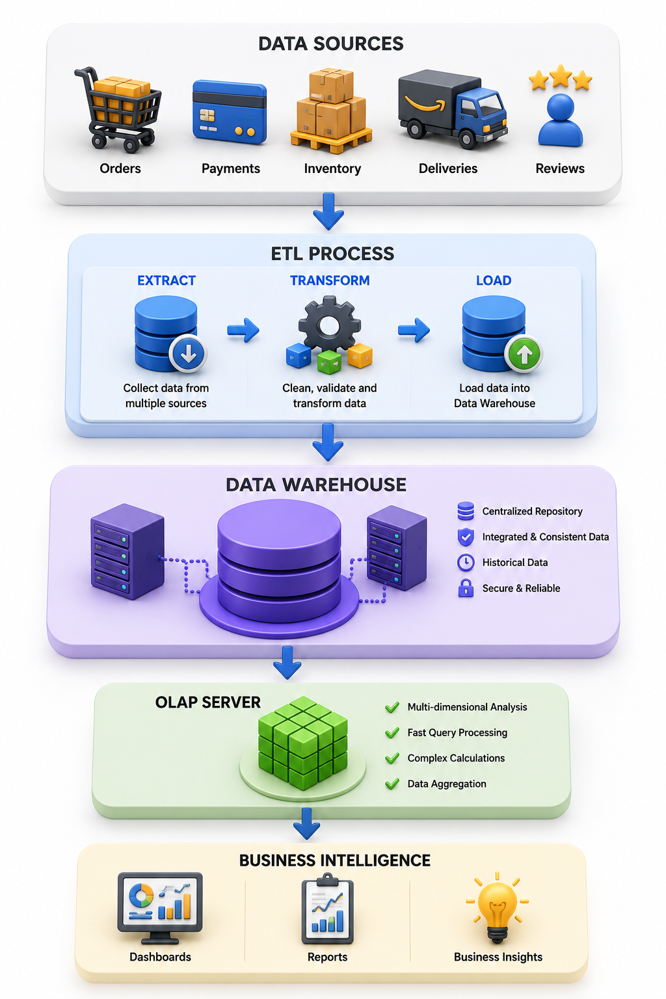
Amazon Data Warehouse Architecture
Data Sources: Customer orders, payments, inventory, deliveries, and reviews are collected from multiple operational systems.
ETL Process: Data is Extracted, Transformed, and Loaded into a centralized Data Warehouse after cleaning and validation.
Central Data Warehouse: Stores integrated, historical, and consistent data for long-term analysis.
Business Intelligence: OLAP, dashboards, and reports help Amazon analyze trends and make smarter business decisions.

Slide 6
Conclusion
Data Warehousing integrates data from multiple sources into a centralized repository for efficient storage and analysis.
ETL ensures data is accurate, consistent, and ready for business intelligence applications.
OLAP and Business Intelligence enable fast analysis, interactive reporting, and data-driven decision-making.
Amazon uses these technologies to optimize inventory, improve customer satisfaction, increase operational efficiency, and drive business growth.

Slide 7
Thank you very much!

